Slide 1

WEEK 3 Transistor Model - BJT
Engineering
Electrical Engineering & Telecommunications
Dr. Aron Michael 2023

Slide 2
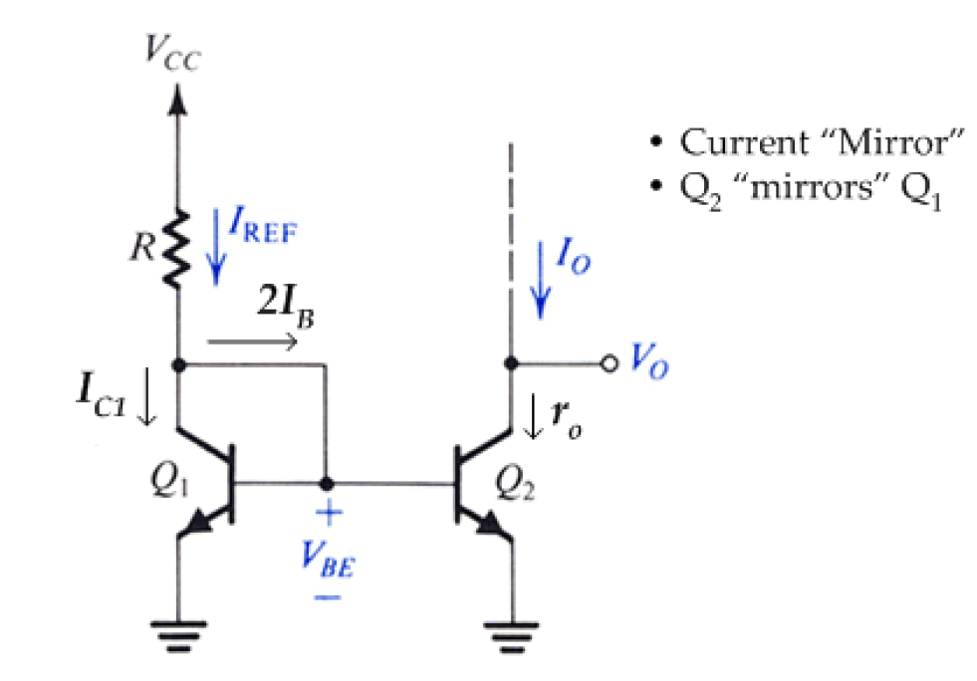
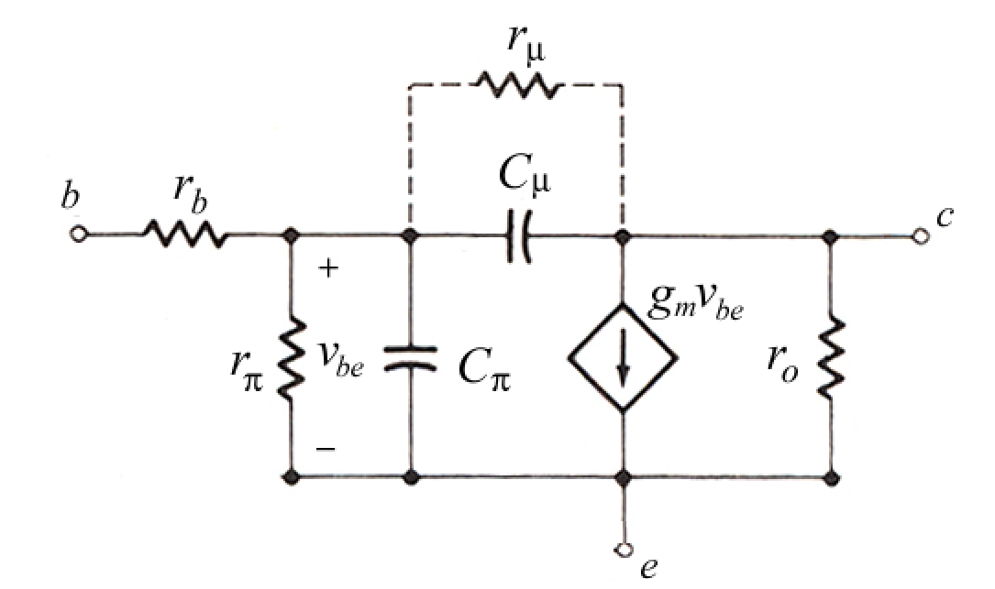



Slide 3
Learning Outcomes
At the end of this week, you will be able to
Draw the small signal circuit model of BJT.
Calculate the small signal circuit model parameters of BJT.
Draw the small signal equivalent circuit of BJT based amplifiers.
Analyze the performance of the amplifiers such as gain, bandwidth, input impedance and output impedance.
Draw the DC equivalent circuit of BJT based amplifiers and calculate the quiescent values (I_{CQ}, I_{EQ}, I_{BQ}, V_{CEQ} ).
Explain DC biasing configurations such as current mirrors.

Slide 4
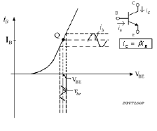
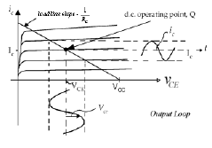


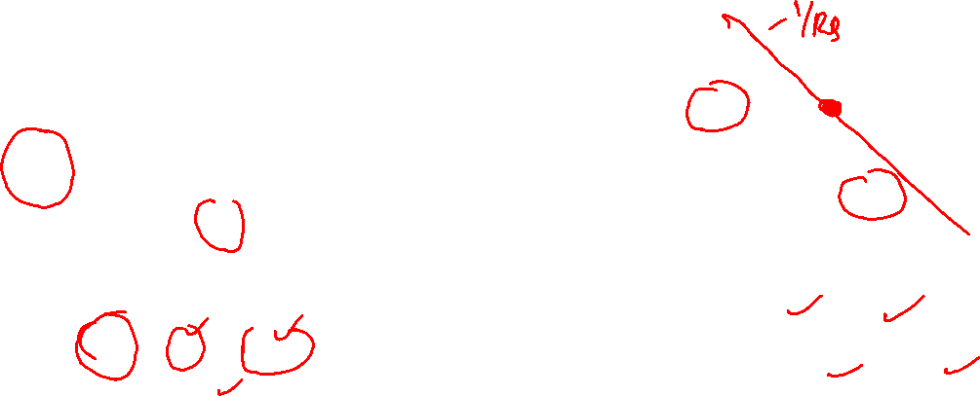


Transistor Circuit Model - BJT
The circuit model will consist of resistors, current controlled current or voltage sources and capacitors
The small signal variations are about a given operating quiescent-point or Q-point (I_{BQ,} I_{CQ,} V_{BEQ,} V_{CEQ})
$i_{C}=$ $i_{c}+I_{CQ}$
$i_{B}=$ $i_{b}+I_{BQ}$
$v_{CE}=$ $v_{ce}+V_{CEQ}$
$v_{BE}=$ $v_{be}+V_{BEQ}$

Slide 5

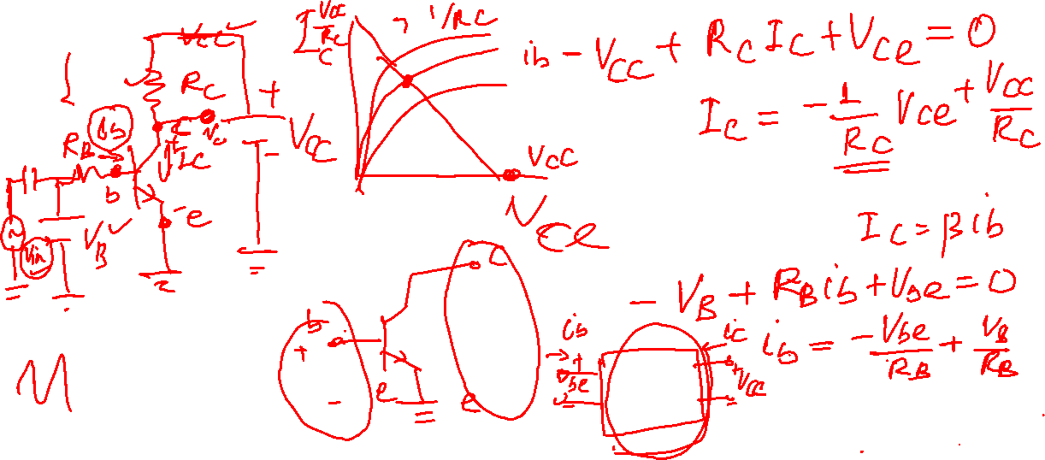



Transistor Circuit Model - BJT

Slide 6
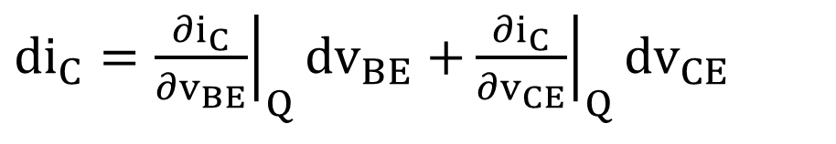
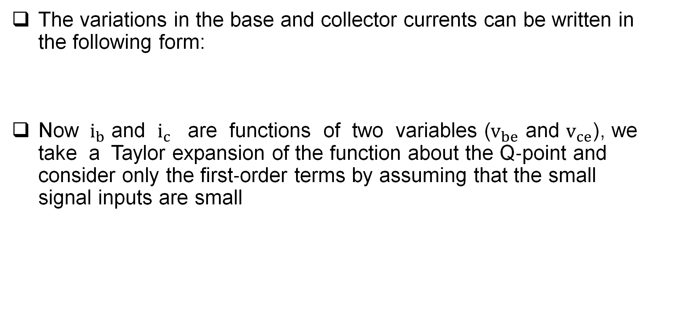


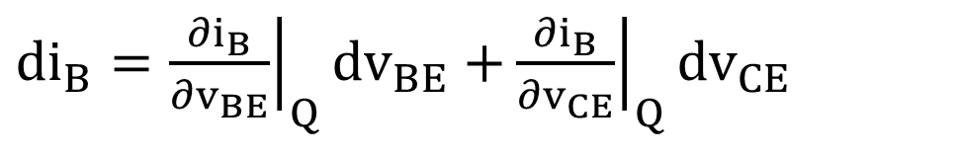



Transistor Circuit Model - BJT
The variations in the base and collector currents can be written in the following form:
Now $i_{b}$ and $i_{c}$ are functions of two variables ($v_{be}$ and $v_{ce}$), we take a Taylor expansion of the function about the Q‐point and consider only the first‐order terms by assuming that the small signal inputs are small
$i_{b}(v_{be},v_{ce})=$ $g_{π}v_{be}+g_{μ}v_{ce}$
$i_{c}(v_{be},v_{ce})=$ $g_{m}v_{be}+g_{o}v_{ce}$
${di}_{B}={\left.\frac{{∂i}_{B}}{{∂v}_{BE}}\right|}_{Q}{dv}_{BE}$ $+{\left.\frac{{∂i}_{B}}{{∂v}_{CE}}\right|}_{Q}{dv}_{CE}$
${di}_{C}={\left.\frac{{∂i}_{C}}{{∂v}_{BE}}\right|}_{Q}{dv}_{BE}$ $+{\left.\frac{{∂i}_{C}}{{∂v}_{CE}}\right|}_{Q}{dv}_{CE}$
$i_{b}=g_{π}v_{be}$ $+g_{μ}v_{ce}$
$i_{c}=g_{m}v_{be}$ $+g_{o}v_{ce}$

Slide 7


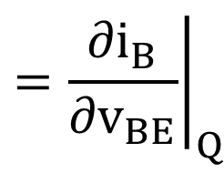
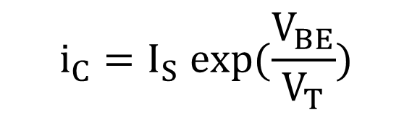






Transistor Circuit Model - BJT
The g_{m}, g_{π}, g_{o} and g_{μ} are parameters that we choose to define the differential conductance:
Determination of g_{m} and g_{π}
From BJT transistor in active mode, V_{BE} and I_{C} are related as follows
$${\left.=\frac{{∂i}_{B}}{{∂v}_{BE}}\right|}_{Q}$$
$${\left.\frac{{∂i}_{B}}{{∂v}_{CE}}\right|}_{Q}$$
$$g_{π}$$
$g_{μ}$ $=$
$$={\left.\frac{{∂i}_{C}}{{∂v}_{BE}}\right|}_{Q}$$
$$={\left.\frac{{∂i}_{C}}{{∂v}_{CE}}\right|}_{Q}$$
$$g_{m}$$
$$g_{o}$$
$$i_{C}=I_{S} exp(\frac{V_{BE}}{V_{T}})$$

Slide 8
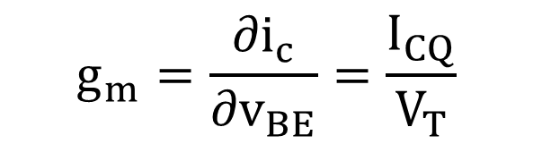
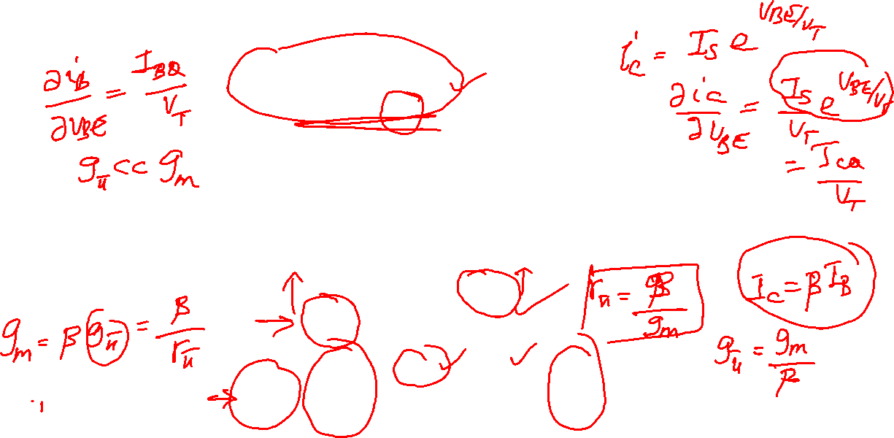
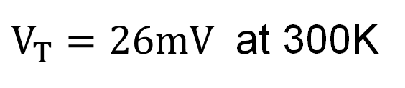

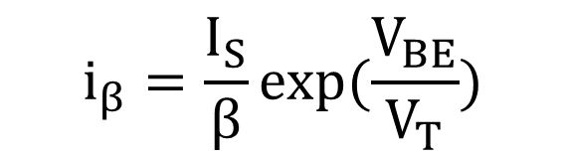
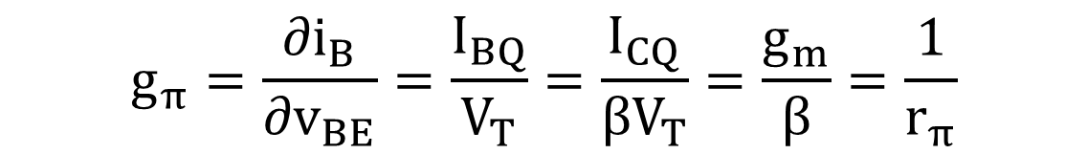
Transistor Circuit Model - BJT
The base current, I_{B},
Assuming I_{S} and β are constant, g_{m} and g_{π} can be obtained by differentiating the above expressions w.r.t. v_{BE} and evaluating at the Q‐point values.
$$i_{β}=\frac{I_{S}}{β}exp(\frac{V_{BE}}{V_{T}})$$
$$V_{T}=\frac{Kq}{T}$$
$V_{T}=26mV$ at 300K
$$g_{m}=\frac{{∂i}_{c}}{{∂v}_{BE}}=\frac{I_{CQ}}{V_{T}}$$
$$g_{π}=\frac{{∂i}_{B}}{{∂v}_{BE}}=\frac{I_{BQ}}{V_{T}}=\frac{I_{CQ}}{βV_{T}}=\frac{g_{m}}{β}=\frac{1}{r_{π}}$$

Slide 9
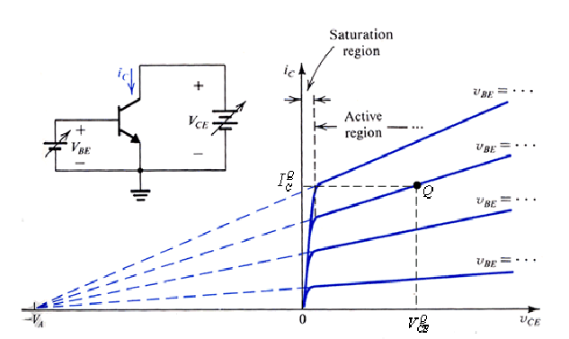
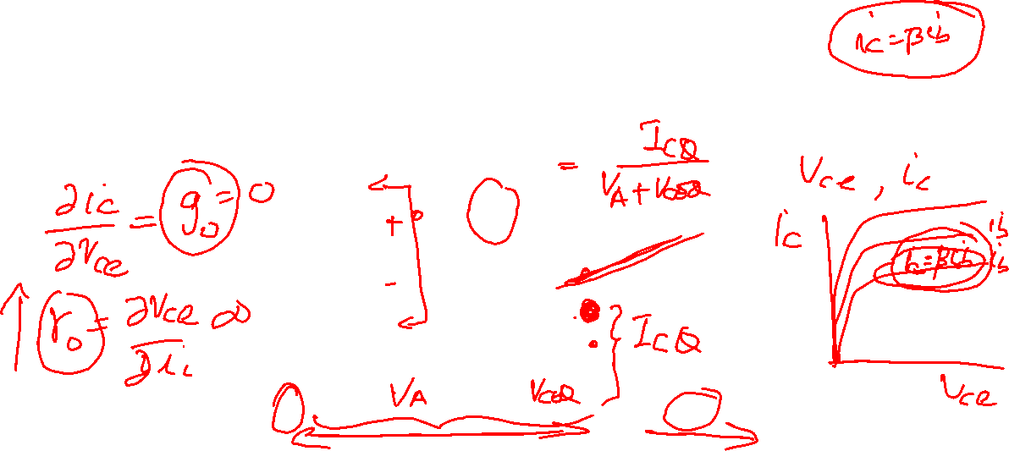
Transistor Circuit Model - BJT
In the active region, i_{C}‐v_{CE} curves are not perfectly horizontal lines, but have finite slopes (as shown in the graph above).
This is caused by an effect known as Base‐Width Modulation (also referred as the Early effect).

Slide 10
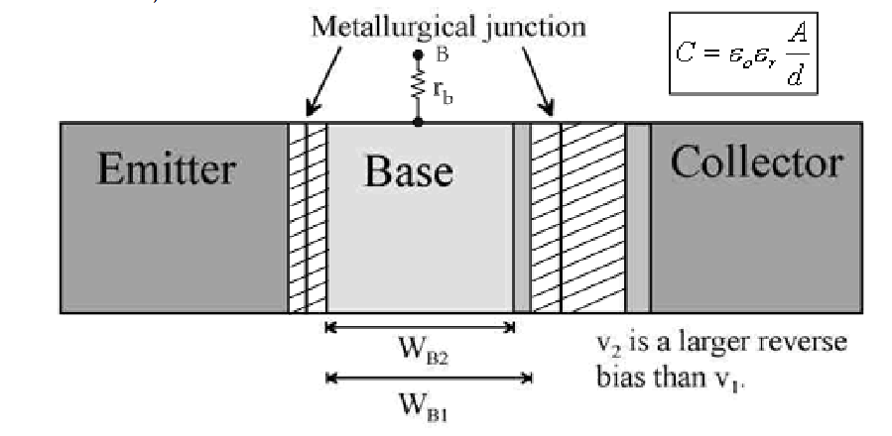
Transistor Circuit Model - BJT
How does Base-width Modulation work?
By increasing v_{CE}, we are increasing the reverse‐bias voltage across the C‐B junction. The depletion region of this junction is thus increased, resulting in a decrease in the effective base width, W.
Since I_{S} is inversely proportional to W, I_{S}, and hence i_{C}, will increase. This is base‐width modulation.

Slide 11


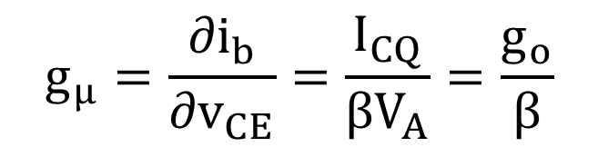

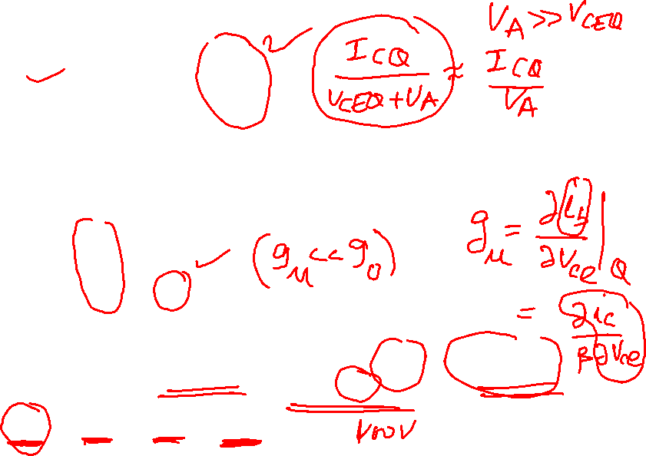


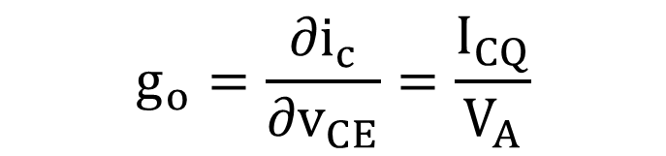



Transistor Circuit Model - BJT
Determinations of g_{o} and g_{u}
By definition ,
this is the slope of the i_{C}(v_{CE}) characteristic, given by the Early effect as:
where V_{A} is early voltage
A note on magnitudes: the g parameters are related as
$$g_{o}=\frac{{∂i}_{c}}{{∂v}_{CE}}=\frac{I_{CQ}}{V_{A}}$$
$$g_{o}=\frac{I_{CQ}}{V_{A}}$$
$$g_{μ}=\frac{{∂i}_{b}}{{∂v}_{CE}}=\frac{I_{CQ}}{{βV}_{A}}=\frac{g_{o}}{β}$$
$$g_{π}=\frac{g_{m}}{β}$$
$${g_{π}≪g}_{m}$$
$$g_{μ}=\frac{g_{o}}{β}$$
$${g_{μ}≪g}_{o}$$
$g_{o}=\frac{g_{π}}{V_{A}}$ $βV_{T}$
$$g_{o}≪g_{π}$$
$${{{g_{μ}≪g}_{o}≪g}_{π}≪g}_{m}$$

Slide 12

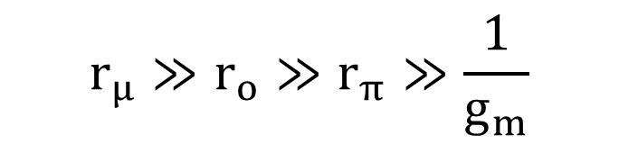

Transistor Circuit Model - BJT
Each of the conductance increments (g_{o}, g_{m}, g_{u}, g_{π}) is directly proportional to the quiescent collector current I_{C} and are functions of temperature and collector voltage.
For β large and V_{T}/V_{A} < 1/β, typically:
If we neglect the effects of base‐width modulation [i.e., V_{A} = –∞],
Example: Given an npn transistor β = 40, I_{C} = 2mA, V_{A} = ‐ 65 volts
g_{m} = 80 mΩ^{‐1} g_{π} = 2 mΩ^{‐1}
g_{o} = 0.031 mΩ^{‐1} g_{μ} = 0.00077 mΩ^{‐1}
$${{r_{μ}≫r}_{o}≫r}_{π}≫\frac{1}{g_{m}}$$
$${{{g_{μ}≪g}_{o}≪g}_{π}≪g}_{m}$$
$${g_{μ}=g}_{o}=0$$

Slide 13
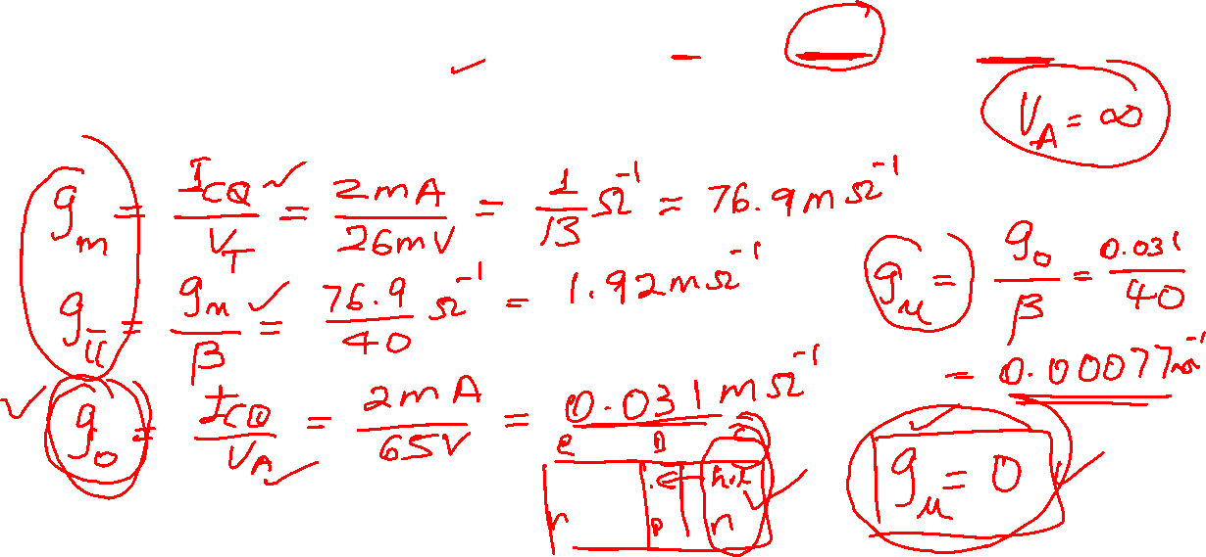
Transistor Model - BJT
Example: Given an npn transistor β = 40, I_{C} = 2mA, V_{A} = ‐ 65 volts
g_{m} = 80 mΩ^{‐1} g_{π} = 2 mΩ^{‐1}
g_{o} = 0.031 mΩ^{‐1} g_{μ} = 0.00077 mΩ^{‐1}

Slide 14
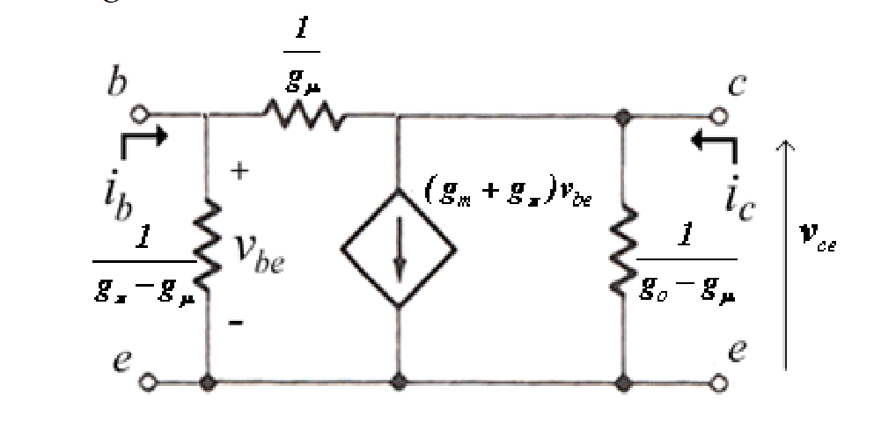
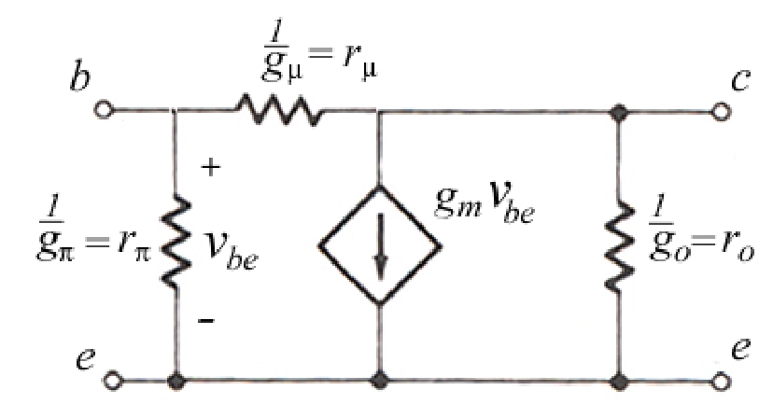
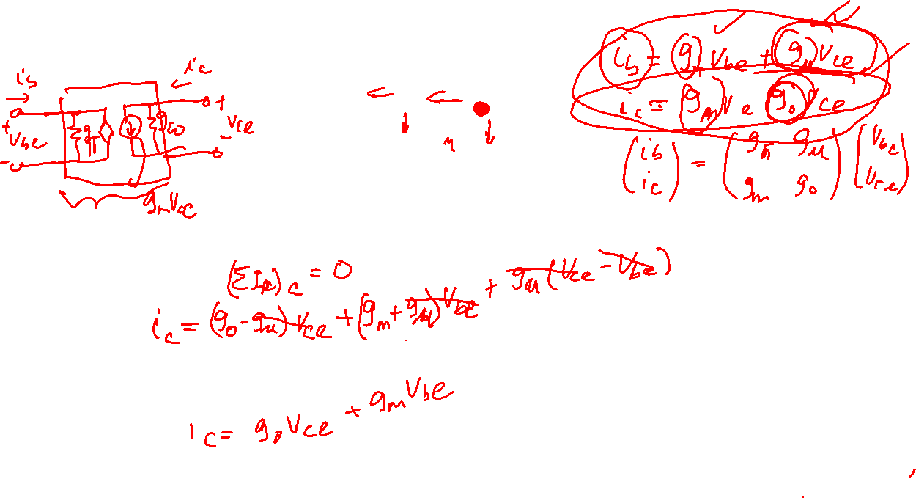

Transistor Model - BJT
Low frequency hybrid-π model
Because of the relative sizes of the g‐parameters, we can simplify the above model to
$${{{g_{μ}≪g}_{o}≪g}_{π}≪g}_{m}$$

Slide 15
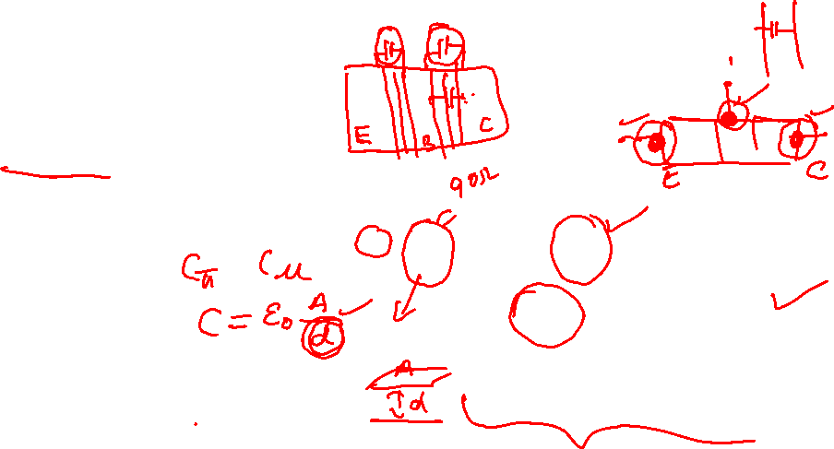
Transistor Model - BJT
The small‐signal model for the BJT, we have so far, is only partially complete. We need to augment the model to incorporate other parameters that relate to the physical structure and physics of operation of the device:
extrinsic resistances
parasitic capacitances
charge‐storage capacitances
The complete hybrid-π is
Typically, C_{π} ≈10‐20pF
C_{μ} is an order of magnitude smaller

Slide 16
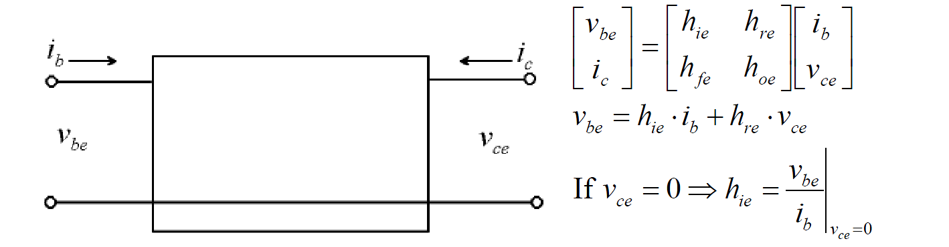









Transistor Model - BJT
BJT can be expressed as a two-port network with emitter as a common terminal for both input and output ports.
The h-parameter is often provided in data sheet by manufacturers
The h-parameters and g-parameters are related as follows
$$h_{ie}=r_{b}+r_{π}$$
$$h_{fe}=g_{m}r_{π}$$
$$g_{o}=\frac{I_{CQ}}{V_{A}}$$
$$g_{m}=\frac{I_{CQ}}{V_{T}}$$
$$r_{π}=\frac{h_{fe}}{g_{m}}=\frac{β}{g_{m}}$$
$$g_{μ}=\frac{g_{o}}{β}$$
$$h_{re}=\frac{r_{π}}{r_{μ}}$$
$$h_{oe}=g_{o}{+ g_{m}h}_{re}$$

Slide 17
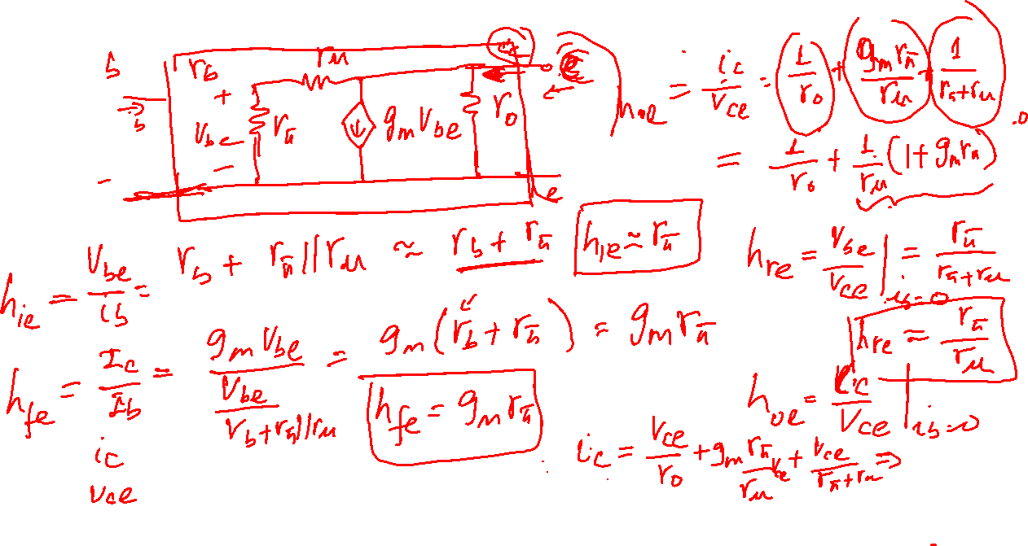
Transistor Model - BJT

Slide 18
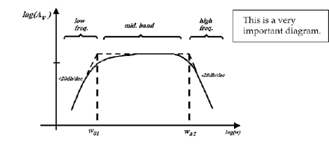
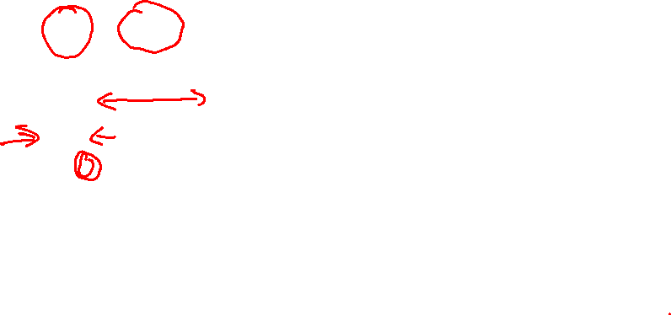
BJT Amplifier – AC Analysis
The above model is the complete model with intrinsic and extrinsic capacitance and resistance. It can be further simplified depending the frequency range in which the amplifier is working.
In mid-band frequency range, the intrinsic capacitances are and have very high impedances ( Z_{c}=1/jwC) because the capacitance values are in the order of pf. Therefore, they can be considered as open. ( note that r_{u} is very large)

Slide 19
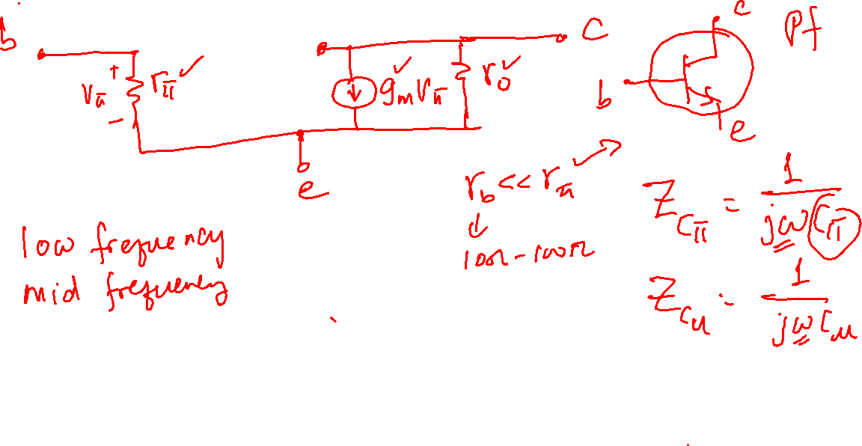
BJT Amplifier – AC Analysis

Slide 20
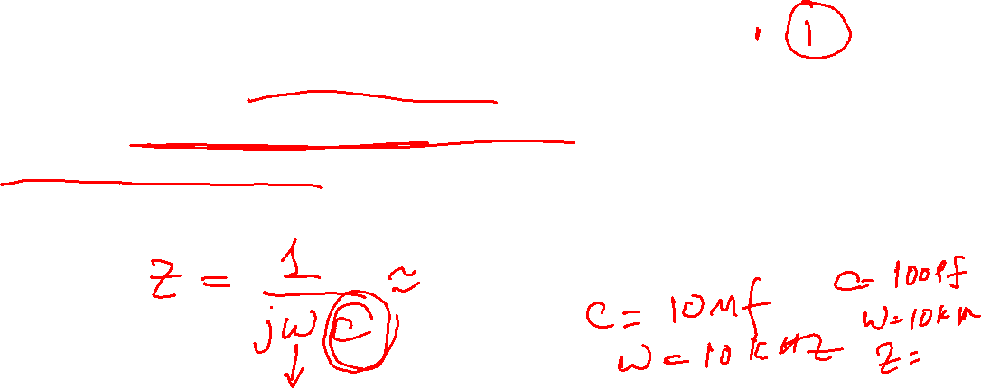

BJT Amplifier – AC Analysis
AC Equivalent Circuit
Steps in finding AC equivalent circuit ( in mid-frequency range)
Disable independent DC sources
DC Voltage sources to ground (or short circuited)
Open circuit - DC current sources
Replace non-linear transistors with linear small signal model
Short large capacitors (in µf range) and open small capacitors (in pf range)

Slide 21




BJT Amplifier – AC Analysis
Example:
Step 1 and 3:
Step 2:

Slide 22


BJT Amplifier – AC Analysis

Slide 23







BJT Amplifier – AC Analysis
Calculate voltage gain ( A_{v}= V_{o}/V_{s})

Slide 24

BJT Amplifier – AC Analysis
Calculate input impedance

Slide 25

BJT Amplifier – AC Analysis
Calculate output impedance

Slide 26

BJT Amplifier – DC Analysis
DC biasing analysis of BJT amplifiers (steps)
Open circuited any capacitor and short circuited any inductor
Calculate the base voltage(s) of the first transistor ( transistors in the first stage) and determine whether the base-emitter junctions are forward biased. If so, assume V_{BE} is around 0.7V.
Further assume that the transistors are in forward active region and apply the normal collector, emitter, and base currents relationships (I_{C},I_{E},and I_{B}). That is, I_{C} = βI_{B.}
Calculate collector and emitter voltages, and check if the assumption of forward active is acceptable. If so, the calculated voltages and currents are DC biasing points. Otherwise, the transistors are in saturation region, in which case V_{CE} = 0.2V.

Slide 27


Transistor Model - BJT
Example 1:

Slide 28
Transistor Model - BJT
Example 1:

Slide 29


Transistor Model - BJT
Example 2:

Slide 30
Transistor Model - BJT
Example 2:

Slide 31

Transistor Model - BJT
Example 3: Determine the voltages at all nodes assume β=100.

Slide 32

Transistor Model - BJT
Example 2:

Slide 33


Transistor Model - BJT
Example 4: Determine the voltages and currents in the amplifier assume β=100.

Slide 34

Transistor Model - BJT
Example 2:

Slide 35

BJT Amplifier – Current Mirror
Transistors can be used to construct constant‐current sources which can in turn be used to bias a number of amplifier circuits.
Since the transistors are matched and on the same chip, the stages will track each other even if there is a change in the temperature or even the power‐supply voltage.

Slide 36

BJE Amplifier – Current Mirror

Slide 37


BJT Amplifier – Current Mirror
Current sources or mirrors are designed to maintain I_{C} at a constant value even when V_{CE} changes.
The Norton‐equivalent circuit of a current source
r_{o} ≡ output resistance of the source, which is the output resistance seen at the collector of Q2.

Slide 38


BJT Amplifier – Current Mirror
Now, it can be shown that the collector current is exponentially dependent on the base‐emitter voltage V_{BE} :
where
I_{S} ≡ the saturation current of the transistor, which depends on the doping concentration and mobility of minority carriers in the base.
Since both transistors in a current source are fabricated on the same wafer, close to each other, the devices are well matched in β, V_{BE} and I_{S}, if they are of identical geometry.
$$I_{C}=I_{S} exp(\frac{V_{BE}}{V_{T}})$$
$$V_{T}=\frac{KT}{q}$$

Slide 39









BJT Amplifier – Current Mirror
Taking KVL in the base loop
Hence,
Taking KVL in the CE loop of Q1
$$β_{1}=β_{2}=β$$
$$I_{C1}=I_{S1} exp(\frac{V_{BE1}}{V_{T}})$$
$$I_{C2}=I_{S2} exp(\frac{V_{BE2}}{V_{T}})$$
$$I_{S1}=I_{S2}$$
$$V_{BE1}=V_{BE2}=V_{BE}$$
$$β_{1}=β_{2}=β$$
$$I_{B1}=I_{B2}=I_{B}$$
$$I_{C1}=I_{C2}=I_{C}$$
$$I_{REF}=\frac{V_{CC}−V_{BE}}{R}=I_{C1}+2I_{B}={βI}_{B}+2I_{B}$$

Slide 40











BJT Amplifier – Current Mirror
$$I_{C1}=I_{C2}=\frac{β}{β+2}I_{REF}=\frac{β}{β+2}\frac{V_{CC}−V_{BE}}{R}={\frac{1}{1+\frac{2}{β}}I}_{REF}$$
For ,
V_{CC} & R set the value I_{C1} and connection to Q1 mirrors I_{C1} onto I_{C2}.
If the effect of the Early Voltage (V_{A}) is included, then we must write:
$$β≫1$$
$$I_{C1}≈I_{REF}$$
$I_{C1}=I_{S1} exp(\frac{V_{BE1}}{V_{T}})$ $\left(1+\frac{V_{CE1}}{V_{A}}\right)$
$I_{C2}=I_{S2} exp(\frac{V_{BE2}}{V_{T}})$ $\left(1+\frac{V_{CE2}}{V_{A}}\right)$
$$V_{BE1}=V_{BE2}=V_{BE}$$
$$I_{S1}=I_{S2}$$
$$β_{1}=β_{2}=β$$
$I_{C2}=I_{C1} \frac{\left(1+\frac{V_{CE2}}{V_{A}}\right)}{\left(1+\frac{V_{CE1}}{V_{A}}\right)}≈I_{C1}$ $\left(1+\frac{V_{CE2}}{V_{A}}\right)$
$$V_{CE1}≈0.7V≫V_{A}≈100V$$

Slide 41




BJT Amplifier – Current Mirror
The output resistance of this simple current source is approximately given by
$I_{C2}≈ I_{C1}$ $\left(1+\frac{V_{CE2}}{V_{A}}\right)≈I_{C1}+\frac{V_{CE2}}{r_{o2}}$
$$r_{o2}=\frac{V_{A}}{I_{C}}$$

Slide 42





BJT Amplifier – Current Mirror
Example:

Slide 43






BJT Amplifier – Current Mirror

Slide 44

BJT Amplifier – Current Mirror

